Slide 1
Logistic Regression Analysis: Voting Likelihood
By: Student Name

Slide 2
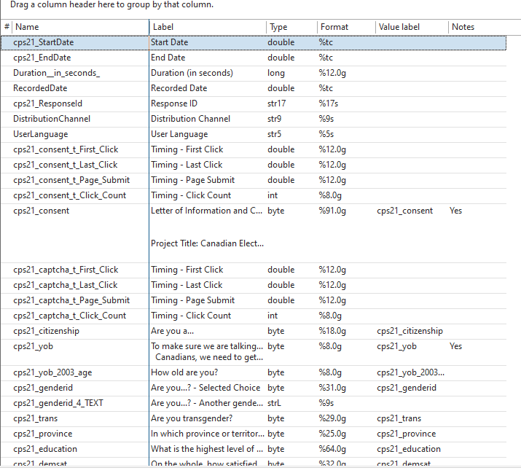
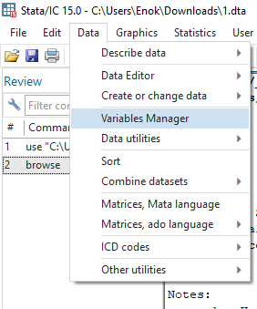
Dependent and Major Independent Variables
choosing Dependent and
Independent Variables
Notes:
First choosing Independent Variables: I Selected independent variables that align with the research focus on voting behavior:
cps21_genderid: Gender
cps21_education: Education level
cps21_province: Province of residence
cps21_turnout_2019: Voting history in the 2019 election
It has more than 300 observations and I created a dummy variable “vote_binary” to represent the binary voting likelihood (1 = likely to vote, 0 = not likely to vote)

Slide 3
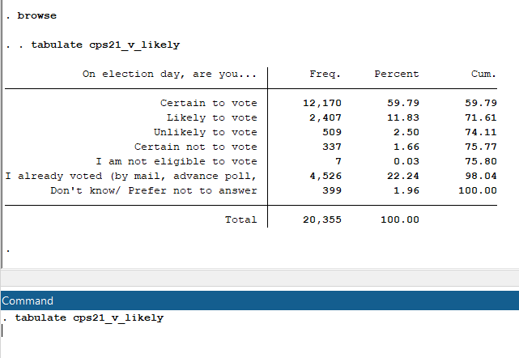
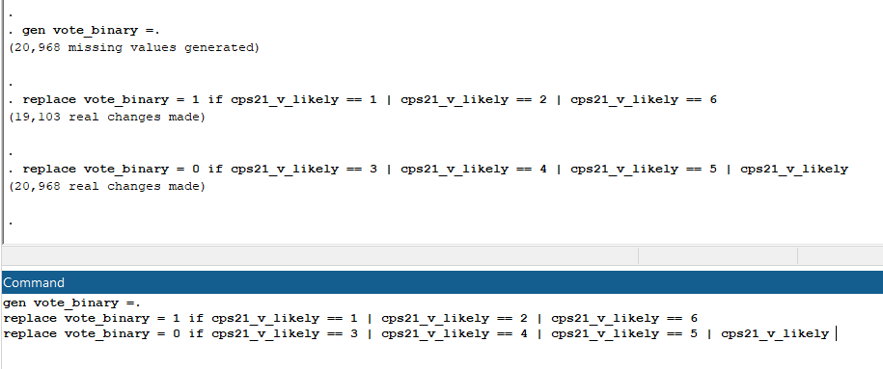
cps21_v_likely has many categories so we create
a dummy variable vote_binary
Notes:
step 1: - dependent variable is cps21_v_likely which measures the likelihood of voting. (check if it meets all conditions negative outcome and positive outcomes)
. tabulate cps21_v_likely
since cps21_v_likely has many categories it makes it challenging to use for logistic regression without transformation so we created a dummy variable vote_binary where:
1 (Positive Outcome): has people who are "Certain to vote," "Likely to vote," or "I already voted."
0 (Negative Outcome): has people who are "Unlikely to vote," "Certain not to vote,"
Step 2: - created vote_binary to represent binary outcome variable (0 and 1) (Stata Command)
gen vote_binary =.
replace vote_binary = 1 if cps21_v_likely == 1 | cps21_v_likely == 2 | cps21_v_likely == 6
replace vote_binary = 0 if cps21_v_likely == 3 | cps21_v_likely == 4 | cps21_v_likely == 5 | cps21_v_likely == 7

Slide 4
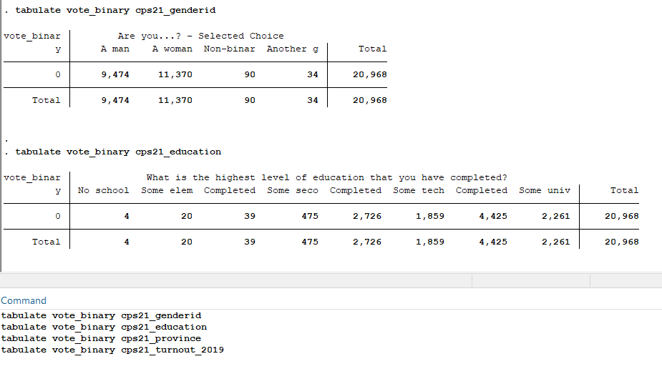
Verify vote_binary in relation to each independent variable
Notes:
step 3: - Verify vote_binary in relation to each independent variable (Stata Command)
tabulate vote_binary cps21_genderid
tabulate vote_binary cps21_education
tabulate vote_binary cps21_province
tabulate vote_binary cps21_turnout_2019

Slide 5
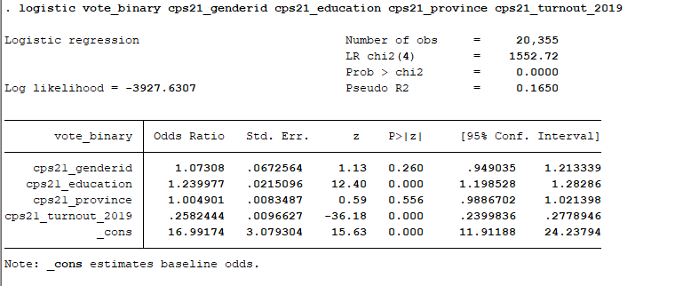
Run Logistic regration
Dependent variable
Major independent variables
Notes:
step 4: - Run Logistic regration (Stata Command)
logistic vote_binary cps21_genderid cps21_education cps21_province cps21_turnout_2019

